Slide 1

Select Topics in Python Creating and Using Lists
Notes:
‹#›

Slide 2

Objectives
Objectives:
Introduction to Lists in Python
Initialize List
Add to List
Calls to List
Sort or Reverse a List
Operations on a List
Slice a List
Display a List
Notes:
‹#›

Slide 3
Introduction to Lists
Lists
Lists contain items separated by commas and enclosed within square brackets.
The values stored in a list can be accessed using the slice operator ( [ ] and [ : ] )
Creating a List
yearBorn = [“Bob Hope”, 1903]
list name
first element: a string
second element: an integer
0 | 1 | 2 | 3 | 4
Indexing a List
Notes:
We need an easy way to hold individual data items without needing to make lots of variables
Making num1, num2, ..., num99, num100 is time-consuming and impractical
Instead, we can use a list to hold our data
A list is a data structure: something that holds multiple pieces of data in one structure
We need an easy way to refer to each individual variable in our list
Math uses subscripts (x₁, x₂, x₃, etc.)
Instructions use numbers (“Step 1: Combine…”)
Programming languages use a different syntax
x[1], x[0], instructions[1], point[i]
Lists don’t start counting from 1
They start counting from 0!
Lists with n elements are numbered from 0 to n-1
The list below has 5 elements, and is numbered from 0 to 4
Heterogeneous (multiple data types!)
Contiguous (all together in memory)
Ordered (numbered from 0 to n-1)
Have instant (“random”) access to any element
Elements are added using the append method
Are “mutable sequences of arbitrary objects”
‹#›

Slide 4
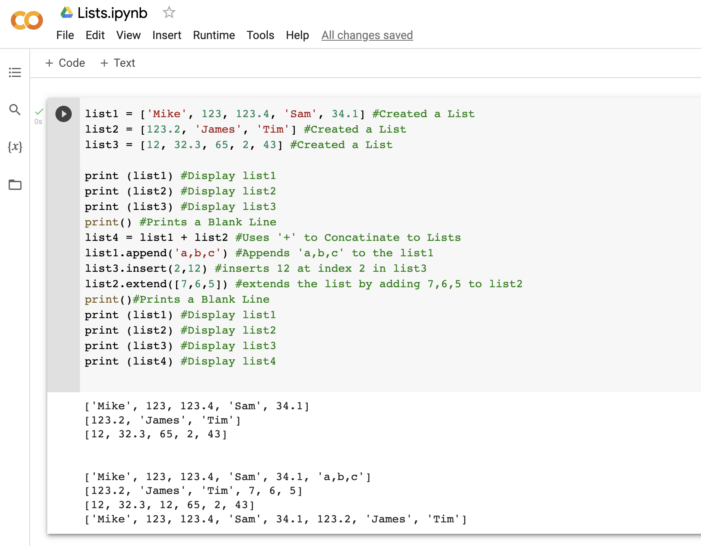
Create and Add to a List
Create
Define a variable name.
Insert items into the list.
Add to a list
Insert.
Extend.
Append.
Concatenate ‘+’
Notes:
extend takes a list as an argument.
append takes a singleton as an argument
‹#›

Slide 5
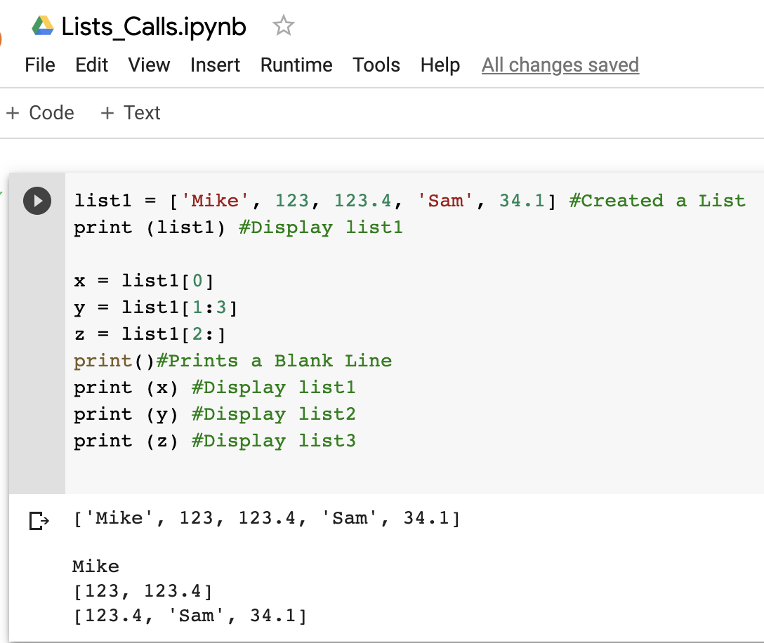
Calls to List
Making calls to a list
Notes:
‹#›

Slide 6
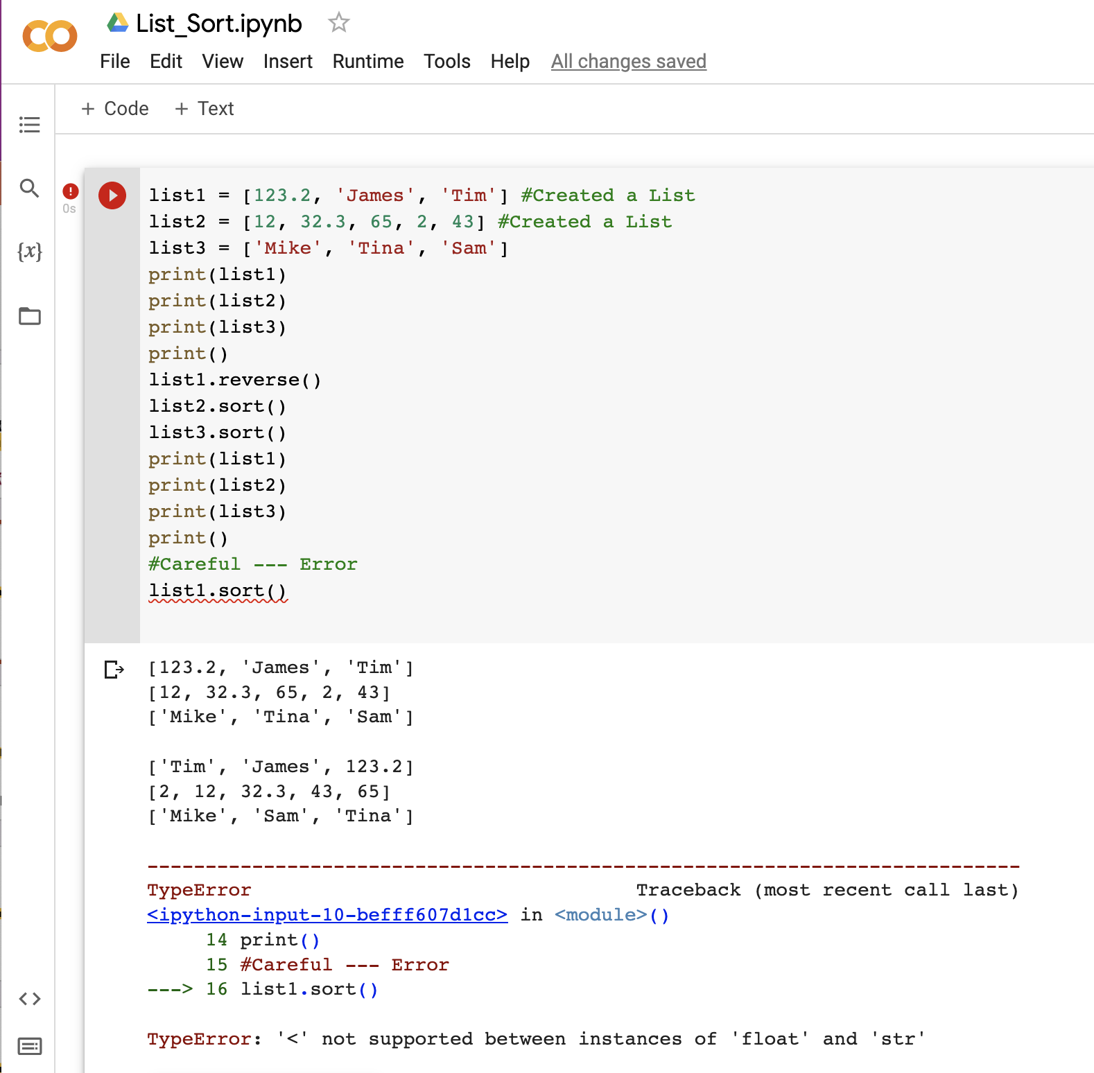
Sort a List
Sort a list
Notes:
‹#›

Slide 7
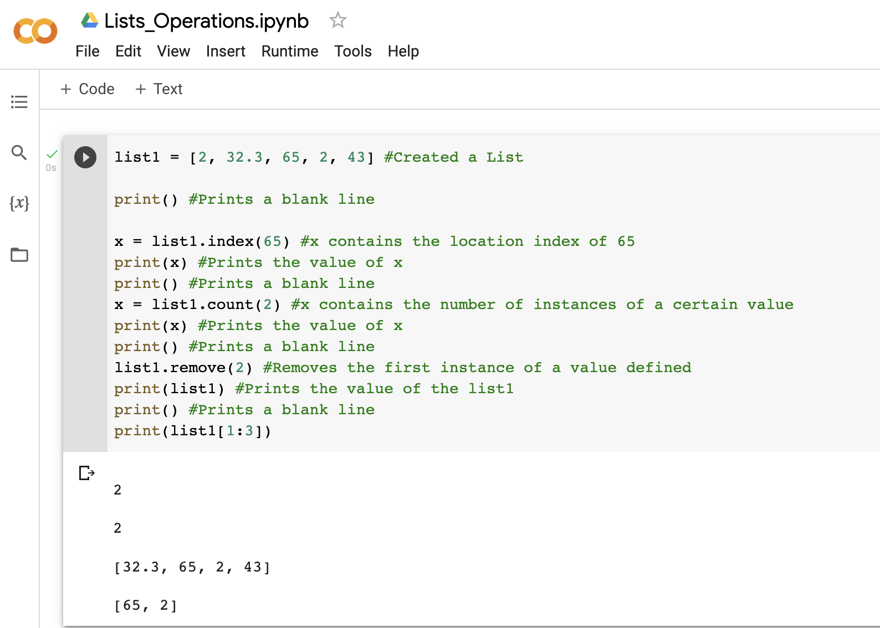
Operations on a List
Operations
Index.
Count.
Remove.
Slice.
Notes:
‹#›

Slide 8
Display a List
Display the list
Notes:
‹#›

Slide 9
Demo
Demo
Notes:
‹#›

